Slide 1

Tech Trends 2024:
Usage, Future Demand, and Industry Insights
Presented by: Nieves Llaca
Date: 28/03/2025

Slide 2

OUTLINE
Executive Summary
Introduction
Methodology
Visualization – Charts & Trends
Dashboards Overview
Discussion & Insights
Findings & Implications
Conclusion
Appendix (Additional Charts & Tables)

Slide 3

EXECUTIVE SUMMARY
🔹 Technology Landscape Analysis
Identified key programming languages, databases, platforms and frameworks in demand.
🔹 Programming Languages Trends
🔹 Database Trends
🔹 Dashboard Visualizations
Showcasing current technology adoption, future trends, and respondent demographics.
🔹 Key Findings & Implications
Industry shifts, emerging technologies, and implications for professionals.

Slide 4

INTRODUCTION
🎯 Purpose: Identify key technology trends shaping the industry, including the generational digital divide.
👥 Target Audience: IT professionals, hiring managers and those interested in generational trends in technology adoption.
📈 Value: Provides actionable insights for career planning, technology adoption, and understanding generational shifts in technology preferences and demands.

Slide 5

METHODOLOGY
📊 Data Source: Developer Survey 2024
🔍 Data Wrangling Steps:
✅ Cleaning and preprocessing the dataset
✅ Filtering relevant technology-related responses
✅ Creating dashboards for visualization

Slide 6
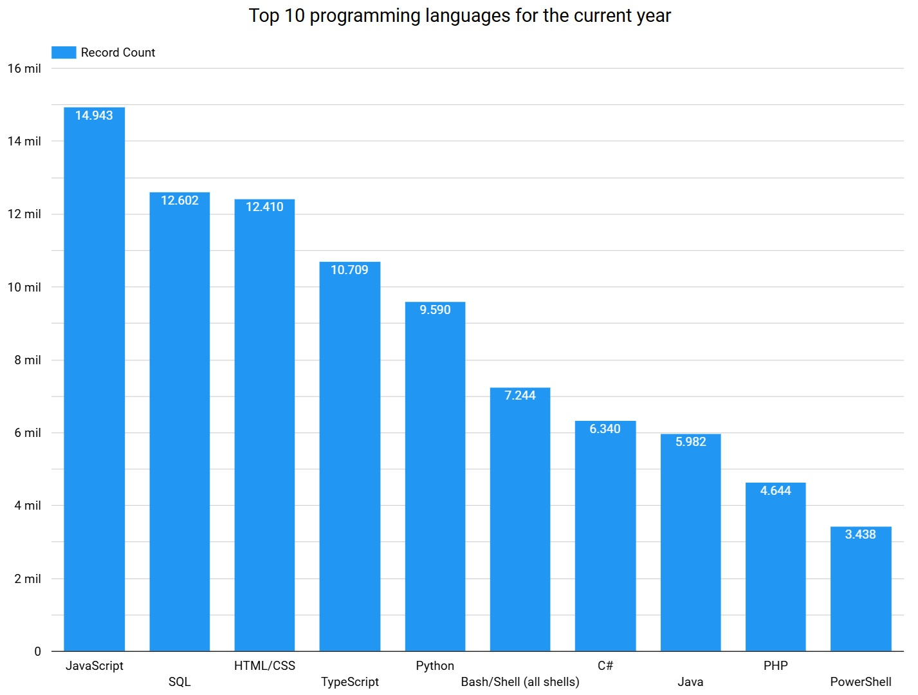
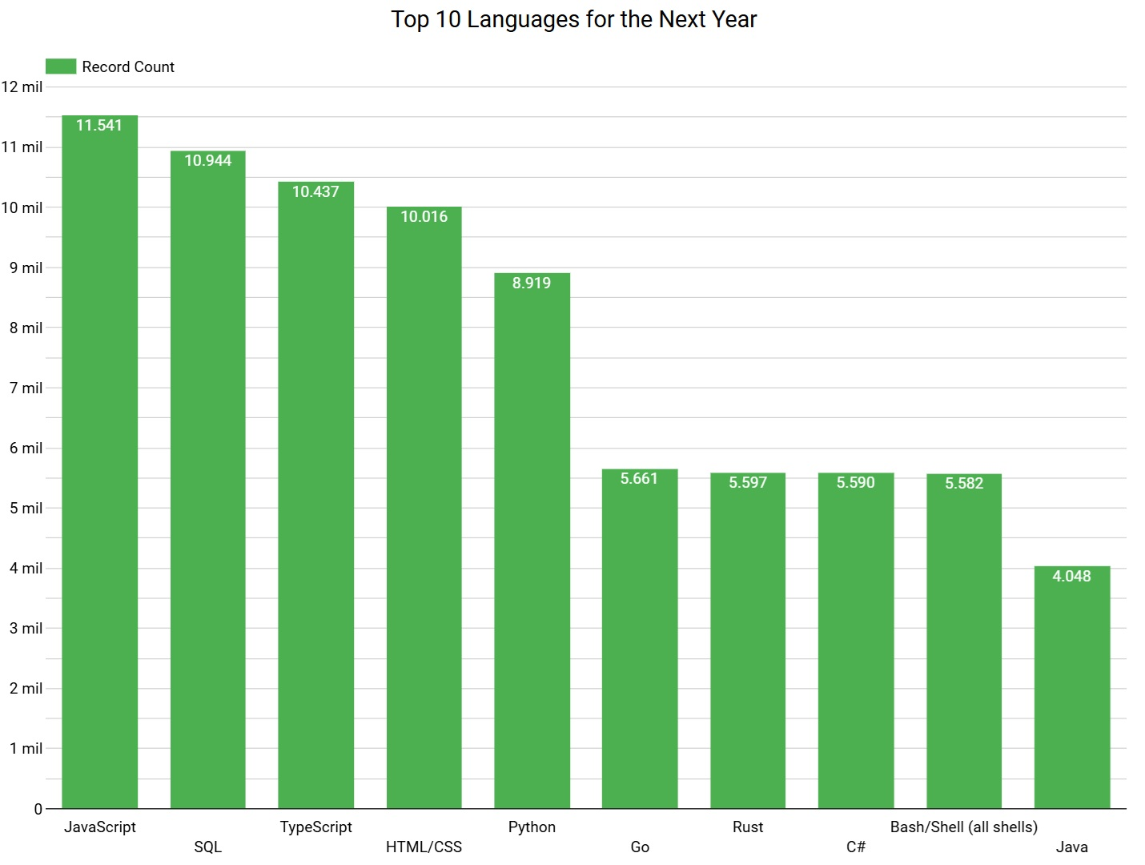
Programming Languages Trends

Slide 7
Programming Languages Trends -Key Insights
Stable Top 5: JavaScript, SQL, HTML/CSS, TypeScript, and Python remain dominant, though JavaScript and SQL see a decrease in total respondents.
Emerging Trends: Go and Rust enter the top 10 for next year, replacing PHP and PowerShell.
Shifting Preferences: Developers show increasing interest in modern, high-performance languages while older technologies decline.
📌 Implication: The industry is gradually shifting towards efficiency-focused languages, indicating evolving technology demands.

Slide 8
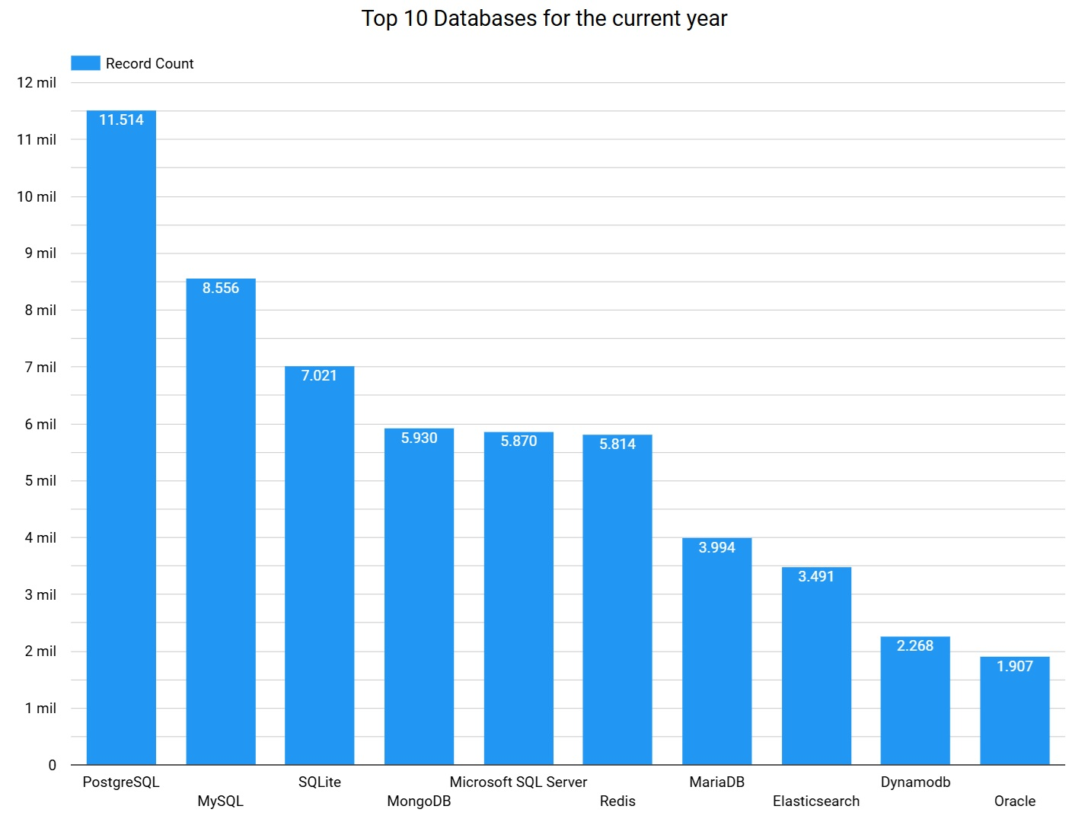
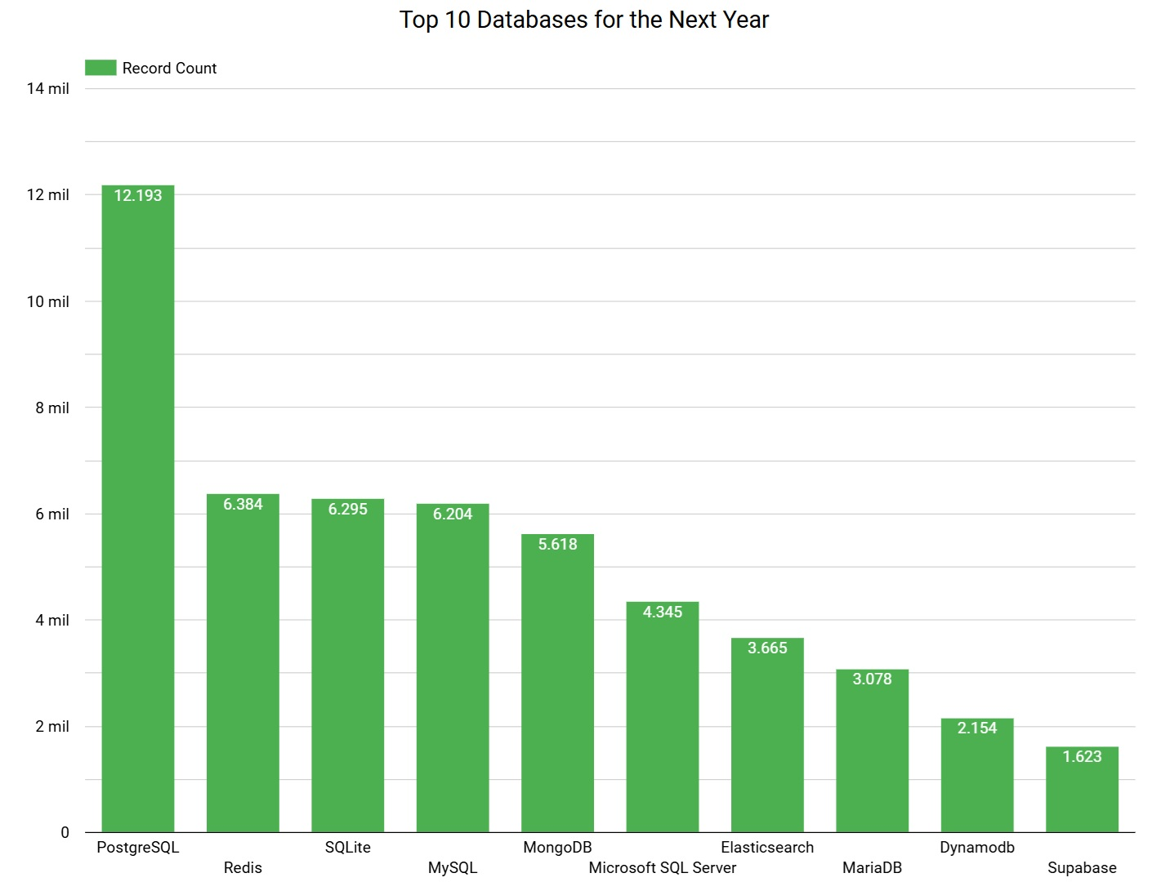
Database Trends

Slide 9
Database Trends – Key Insights
Stable Top 5: PostgreSQL, MySQL, SQLite, MongoDB, and Microsoft SQL Server remain dominant, with PostgreSQL showing a slight increase in responses.
Emerging Trends: Redis rises in popularity, and Supabase enters the top 10, replacing Oracle, which disappears from the rankings.
Shifting Preferences: Developers are increasingly turning to Redis and PostgreSQL, while traditional databases like Oracle and MySQL show a decline.
📌 Implication: The industry is shifting towards more modern, scalable, and cloud-native databases, reflecting a growing demand for flexibility and performance.

Slide 10
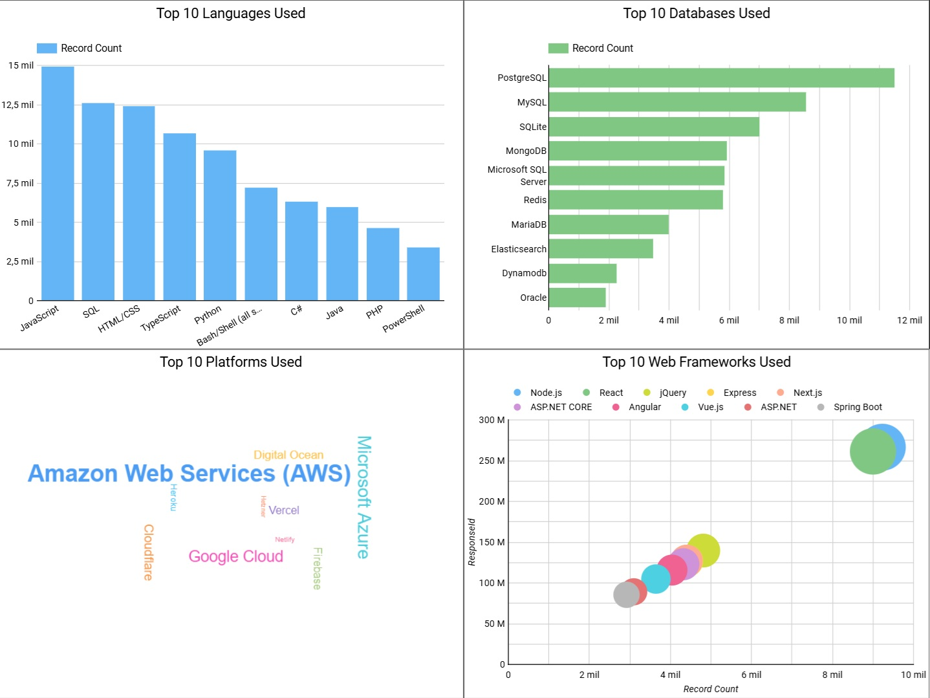
Current Technology Usage

Slide 11
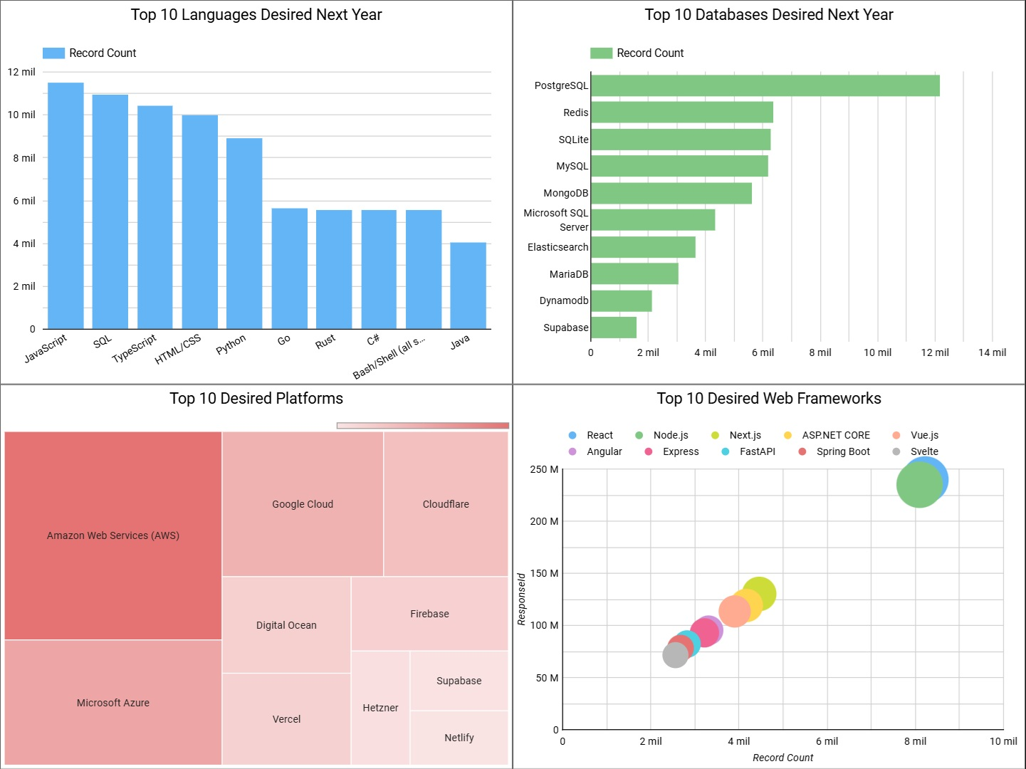
Future Technology Trends

Slide 12
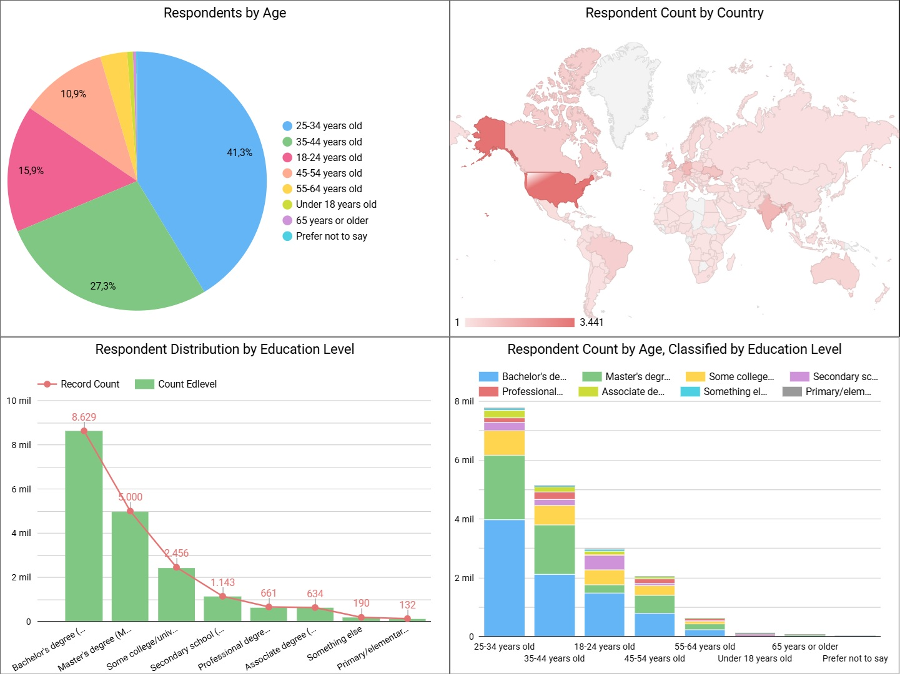
Demographics

Slide 13
DISCUSSION
Platforms: AWS, Microsoft Azure, and Google Cloud maintain their top positions, with Supabase replacing Heroku in the top 10, indicating a shift towards modern, open-source cloud solutions.
Web Frameworks: Node.js and React remain dominant, while jQuery and ASP.NET disappear from future trends. New frameworks like FastAPI and Svelte emerge, showing a preference for more lightweight and efficient technologies.
Age: Most respondents are 25-34 years old (41%), followed by 35-44 years (27%), highlighting the younger demographic's impact on tech adoption.
Top Countries: The highest number of respondents come from the United States, Brazil, and India.
Education: The majority have a Bachelor's degree (8k), followed by a Master's degree (6k), showing a highly educated respondent pool.
📌 Implication: Companies must focus on upskilling younger professionals and embracing emerging cloud platforms and lightweight frameworks to stay ahead in the evolving tech landscape.

Slide 14
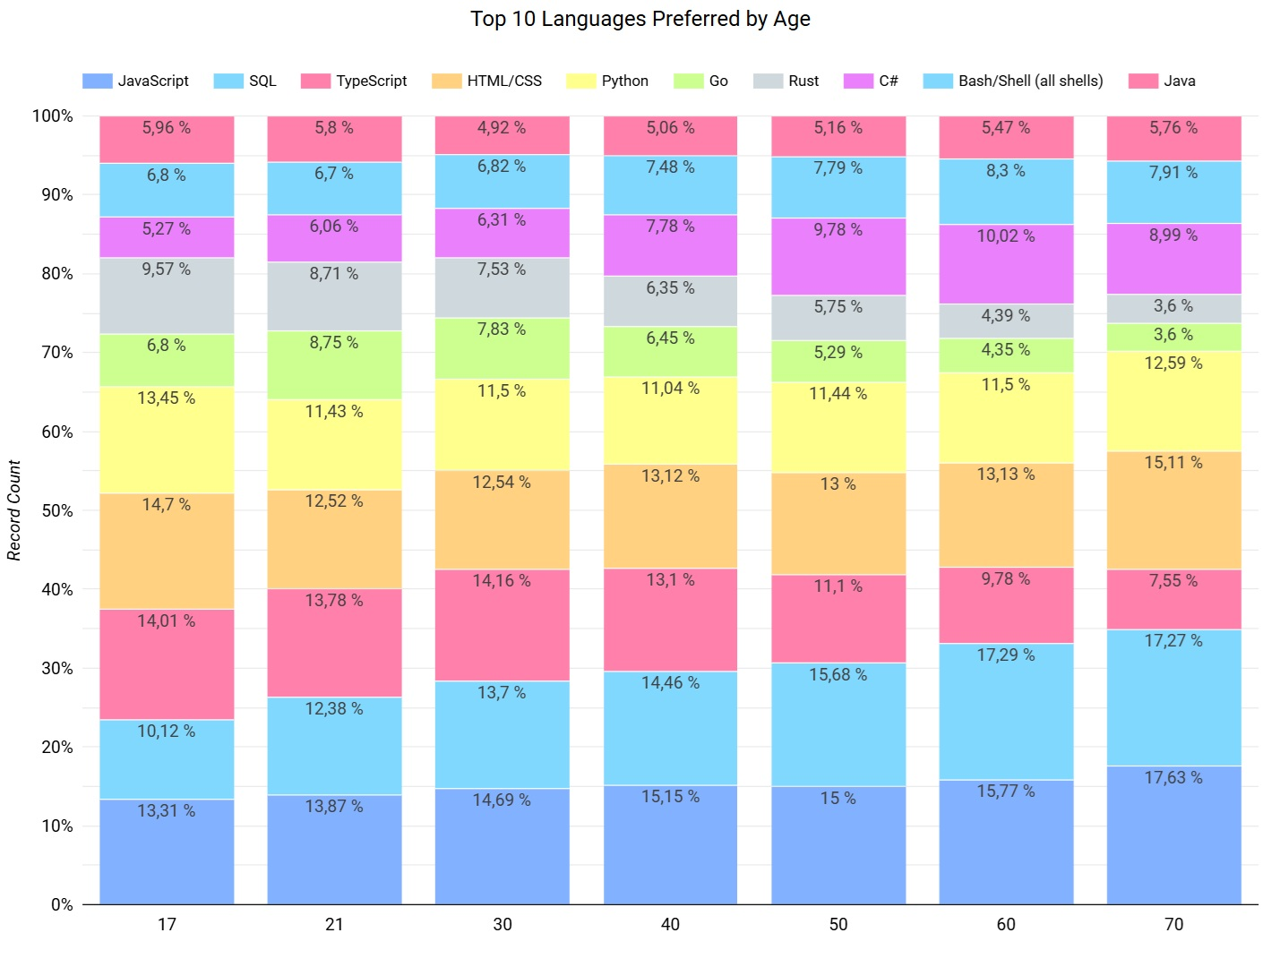
Programming Languages Preferences by Age
JavaScript and TypeScript are widely used across all age groups, with a peak in younger generations.
Python and SQL are popular, especially in the 18-34 age range.
Rust and Go are favored by younger age groups but drop off with older generations.
C# grows in preference with age, especially among those 45+.
*Age group: Under 18 years old = 17; 18-24 years old = 21; 25-34 years old = 30; 35-44 years old = 40; 45-54 years old = 50; 55-64 years old = 60;
65 years or older = 70. The option 'Prefer not to say' is not counted.

Slide 15
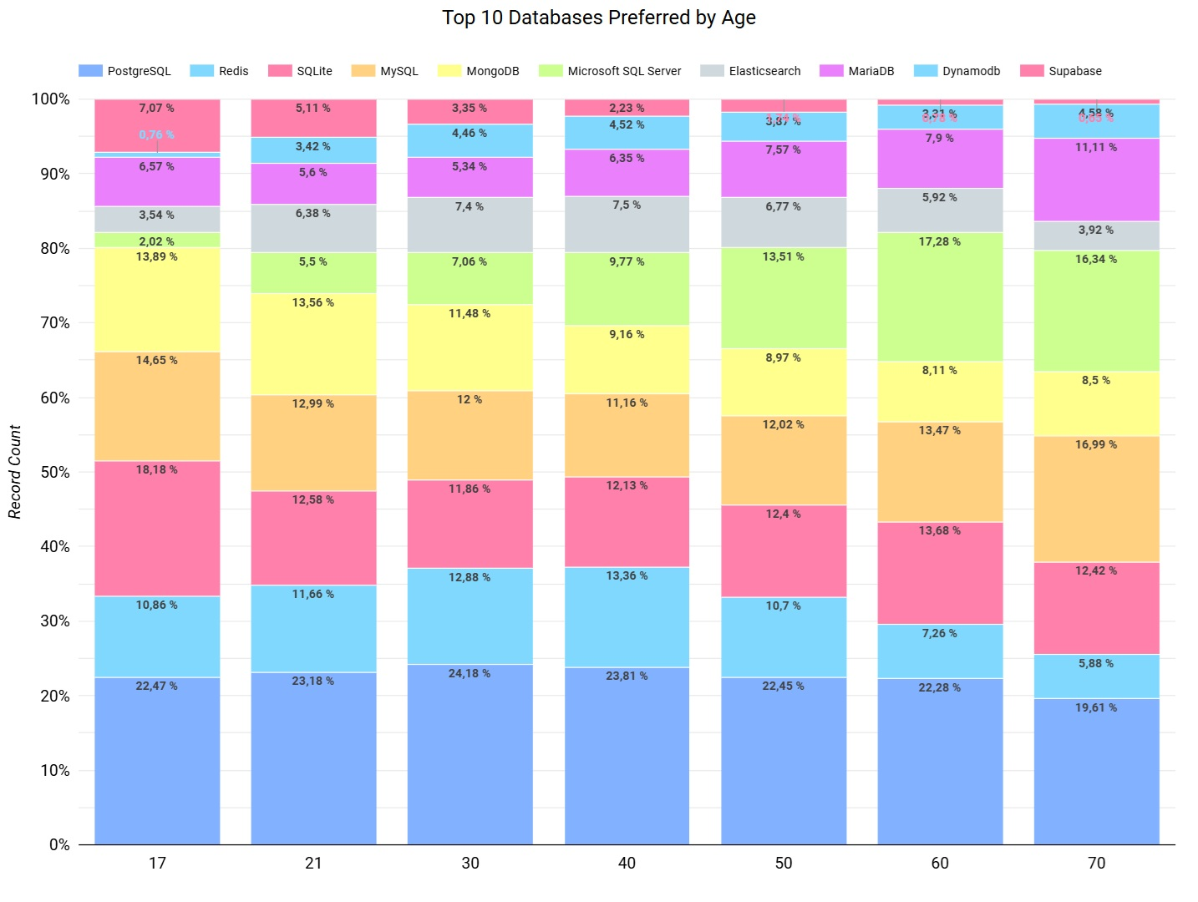
Databases Preferences by Age
PostgreSQL is widely used across all age groups, with a slight preference among 25-34-year-olds.
SQLite is popular with younger users but decreases in older age groups.
MySQL is consistent across all age groups, especially favored by the under-18s and 65+.
Redis is gaining popularity in the 25-44 age range, but barely used by those under 18 and older groups.
Supabase shows potential among younger generations but is not used much by older age groups.
*Age group: Under 18 years old = 17; 18-24 years old = 21; 25-34 years old = 30; 35-44 years old = 40; 45-54 years old = 50; 55-64 years old = 60;
65 years or older = 70. The option 'Prefer not to say' is not counted.

Slide 16
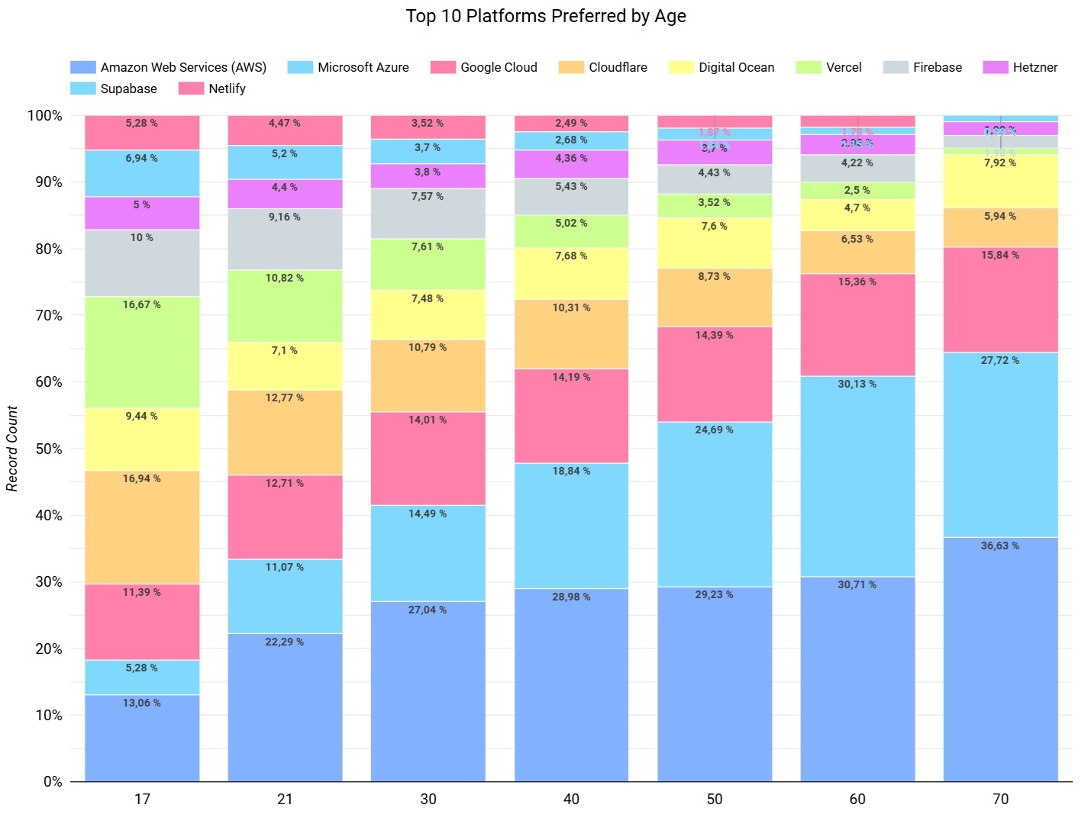
Platforms Preferences by Age
AWS dominates across all age groups, with stronger preference among older users.
Microsoft Azure becomes more favored with age.
Google Cloud is more popular with younger groups but declines in older generations.
Cloudflare and Supabase are more appealing to younger users.
The cloud platform market is more diverse among younger generations, while older professionals tend to rely on AWS, Microsoft Azure, and Google Cloud as the dominant choices.
*Age group: Under 18 years old = 17; 18-24 years old = 21; 25-34 years old = 30; 35-44 years old = 40; 45-54 years old = 50; 55-64 years old = 60;
65 years or older = 70. The option 'Prefer not to say' is not counted.

Slide 17
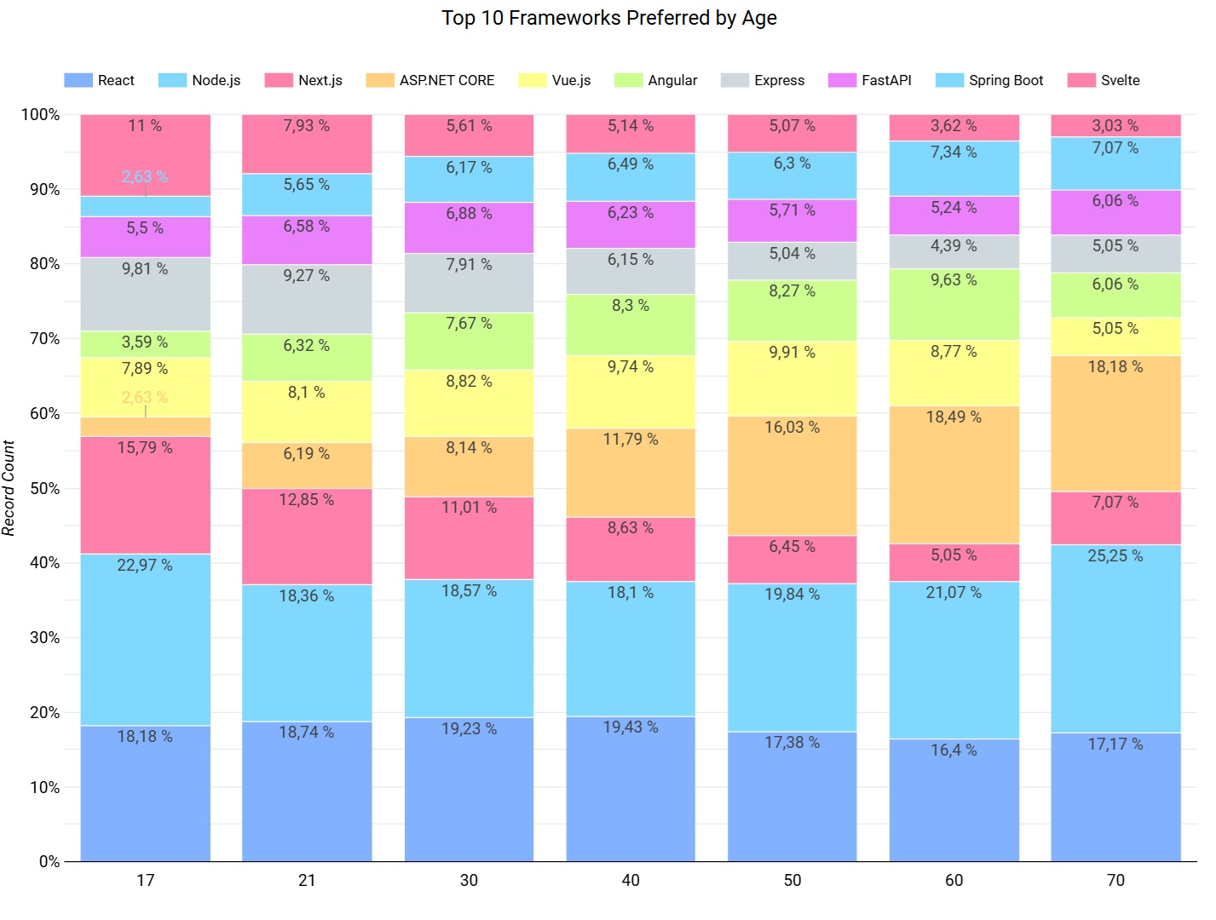
Web Frameworks Preferences by Age
React and Node.js dominate younger groups, while React remains strong into mid-career stages.
Next.js is steady among younger users but declines with age.
ASP.NET Core gains traction in older groups, with minimal use among the youngest.
Vue.js and other emerging frameworks are more popular among younger developers but see less adoption in older groups.
The web framework market is more diverse among younger developers, while older groups rely on fewer dominant technologies.
*Age group: Under 18 years old = 17; 18-24 years old = 21; 25-34 years old = 30; 35-44 years old = 40; 45-54 years old = 50; 55-64 years old = 60;
65 years or older = 70. The option 'Prefer not to say' is not counted.

Slide 18
Overall Findings & Implications
🔹 Generational shift in preferences: Younger generations (under 18 to 35-44) favor newer technologies like React, Node.js, Redis, and Supabase, which are commonly used in AI and machine learning applications. This indicates a growing interest in AI-driven technologies, though not explicitly stated in the data.
🔹 AI and modern technologies: Younger groups are embracing AI-related technologies like Python and modern web frameworks, while older generations lean towards more established, legacy tools.
🔹 Growing interest in high-performance languages: Rust and Go are trending with younger age groups (18-44), indicating a preference for performance-driven languages, while older generations prefer more familiar options like SQL and C#.
🔹 Platform preference: AWS and Microsoft Azure dominate among older groups, while younger generations are more inclined towards newer platforms like Google Cloud, Cloudflare, and Supabase.

Slide 19
Overall Findings & Implications
📌 Industry Implications:
To attract younger talent, industries should consider adopting newer technologies like React, Node.js, Redis, and Supabase, which are not only trendy but also aligned with the growing demand for AI, machine learning, and data-driven solutions.
Older generations tend to prefer traditional, reliable technologies like C#, PostgreSQL, ASP.NET Core, and AWS, which could be crucial for industries with a more mature workforce.
The adoption of newer technologies may also signal a shift toward innovation and future-proofing, especially for industries looking to remain competitive in attracting a young, tech-savvy workforce.

Slide 20
CONCLUSIONS
🔹 Generational Shift and Emerging Technologies: Younger generations are increasingly adopting modern technologies such as Python, Node.js, and Redis, which are commonly used in AI, machine learning, and high-performance applications. This reflects the rising influence of AI-driven technologies among younger developers.
🔹 Adoption of Cloud & Open-Source Solutions: Cloud platforms like AWS, Microsoft Azure, and Google Cloud maintain their dominance, with a growing preference for open-source solutions like Supabase. Companies need to modernize their cloud strategies and consider the increasing shift toward open-source options.
🔹 Database & Framework Shifts: The industry is moving towards cloud-native, scalable databases like Redis and PostgreSQL, and frameworks that are lightweight and performance-focused, such as FastAPI and Svelte. This shift indicates a demand for technologies that provide flexibility and scalability for evolving business needs.
🔹 Focus on Education & Upskilling: A majority of respondents hold Bachelor's and Master's degrees, emphasizing the importance of continuous learning and upskilling to stay competitive in the technology space.
🔹 Key Implication: To remain competitive and attract top talent, companies must invest in modern technologies, emphasize continuous learning and development, and ensure they are aligned with the preferences of younger generations.

Slide 21

APPENDIX
🔹 Bar chart illustrating the relation between popular programming languages and demand in the job market (measured by number of postings).
🔹 Bar chart illustrating the relationship between programming languages and average annual salary in USD.

Slide 22
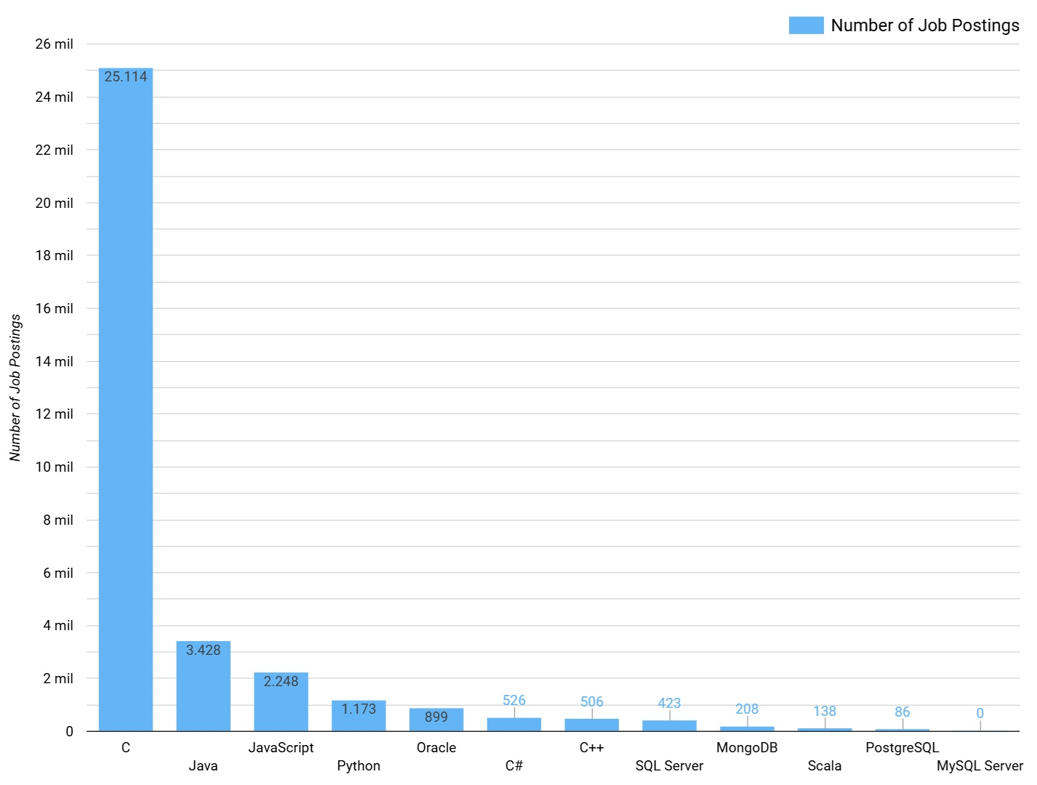
Job Postings and Popular Languages

Slide 23
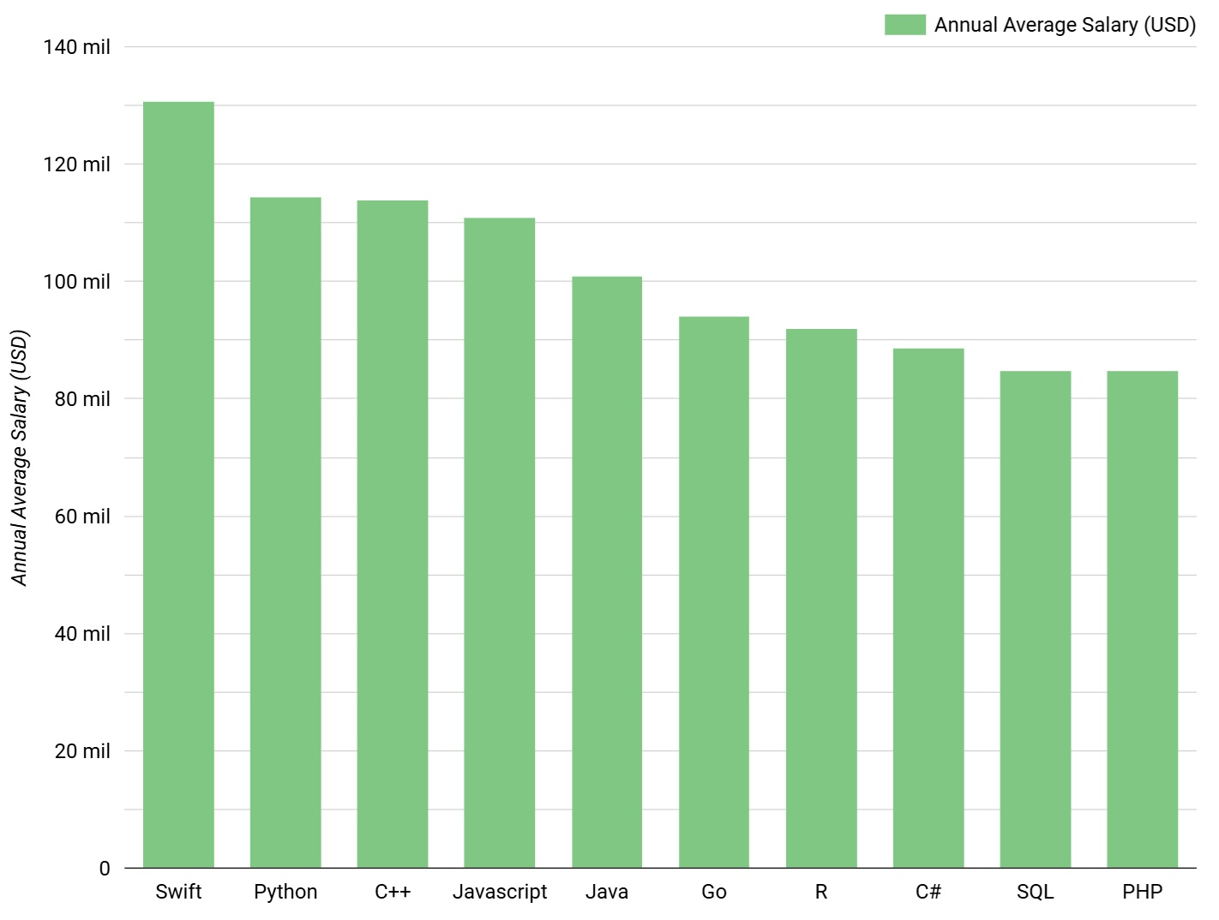
Popular Languages and Average Salary

